Slide 1
Sustainability on Stage 3
Classroom presentation

Slide 2
Learning outcomes
Description
The students will learn about Stage 3 sustainability challenges and considerations, and how the project team mitigate these. The presentation will feature a demonstration of the ‘Cod Father’ a remote-controlled water quality testing boat which is a Queensland first use case for a construction project, and other sustainability initiatives.
Students will have the opportunity to undertake their own experiment in small groups to clean water using a filtration technique built by themselves.
Age group
Years 7 and 8
Lesson timing
Approximately 90 minutes
Resources
Printed Careers in Construction flyer
Audio-visual equipment
Experiment materials
Aims
Consider the environmental impacts when designing a project such as Stage 3
Explore how innovative sustainable design can positively impact the environment
Explore a career pathway for a career in the sustainability industry
Create awareness about environmental issues and foster a desire for sustainability.
Lesson extension ideas
Create a competition to see which group can achieve the cleanest water or go through the process with different pollution levels and explore the differences in how long it takes to clean the water.
Broad Australian Curriculum alignment
Cross Curriculum Perspectives
Sustainability: Design
Design and Technologies
Knowledge and Understanding: Technologies
and Society
Print copies of the ‘Careers in Construction’ flyer and hand out to students while discussing the different roles in a project.

Slide 3
Outline
Transport planning
Gold Coast Light Rail Stage 3 (Stage 3)
Careers in construction
Environmental and sustainable advisor roles
Stage 3 sustainability initiatives
Sustainability video
Activity – water quality experiment

Slide 4
How can effective transport planning help connect people from different neighbourhoods to essential services like schools, hospitals, and shopping centres?
Notes:
Learning extension tips – Discuss the importance of transport planning with students after watching the video

Slide 5
Benefits of transport planning and Stage 3
Integrated network: It makes sure different types of transport, like buses, trains, and bikes, work well together. This helps people switch between them easily and get where they need to go faster.
Connecting people and places: Good transport planning connects neighbourhoods, making it easier for people to reach jobs, schools, and other important places. This helps communities stay connected and active.
Accessibility: It considers everyone’s needs, including people with disabilities and the elderly. It makes sure transport options are available, affordable and easy to use for everyone.
Reducing congestion: By planning better routes and encouraging public transport, it helps reduce traffic jams, making travel smoother and quicker.
Safe travel: Safety is a big focus, with measures to protect everyone, including pedestrians and cyclists.
Reducing travel time: Efficient transport planning cuts down on travel time, so people can spend more time doing what they enjoy and less time commuting.
Improving network efficiency: It makes the whole transport system work better, ensuring resources are used wisely and services run smoothly.
Economic contribution: A well-planned transport system boosts the economy by improving access to markets, lowering transportation costs, and attracting businesses.

Slide 6
Class questions
Who has travelled on the light rail already?
How do you travel to and from school?
What modes of transport have you used to get to a beach or friends house?
Notes:
Learning extension tips – Explain what a ‘mode’ of transport is - A mode of transport is a way of moving people or goods from one place to another. Common modes of transport include cars, buses, trains, airplanes, ships, bicycles, walking and of course light rail!

Slide 7
About our Gold Coast trams
Since 2014 G:link has carried more than 94 million passengers
Trams can travel up to 70 km/hr
Standing 3.4 metres high, 2.65 metres wide and 43.5 metres long
The trams are bi-directional which means they can travel in both directions, with a cab at each end
Designed for a capacity of up to 309 people, the trams feature air conditioning, wheelchair and multipurpose areas and even surfboard racks.

Slide 8
Welcome to Gold Coast Light Rail Stage 3
Did you know?
More than 6,400 students live within 2km of Stage 3.
Let’s take a look at the project…

Slide 9
What jobs do we have on Stage 3? – local people building a local project

Slide 10
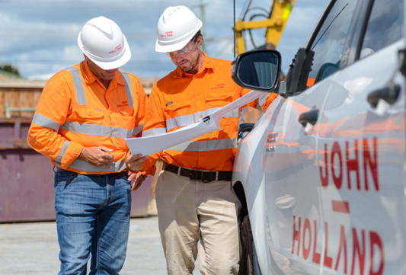
Who builds this project?
Technical roles
Workforce roles
Management and administrative roles
These include positions that focus on the technical aspects of the project, such as engineers, architects, surveyors, environmental advisor, and site supervisors. They ensure that the project is designed and built according to specifications and safety standards.
This category encompasses the entry level, apprentice and trainee labour force, including carpenters, electricians, plumbers, and general construction workers. These individuals are directly involved in the physical construction of the project.
These roles involve planning, coordinating, and overseeing the project. They include project managers, contract managers, procurement officers, training and administrative staff, media and community engagement officers.

Slide 11
Stage 3 roles
There are several types of sustainability and environmental jobs on construction projects, each playing a vital role in promoting eco-friendly practices and ensuring compliance with environmental regulations.
Environmental Engineer
Environmental Advisor
Sustainability Manager
Designs and implements solutions to minimise the environmental impact of construction activities, such as waste management, water treatment, and pollution control.
Conducts inspections and testing to ensure that construction sites comply with environmental regulations and standards, identifying potential issues and recommending corrective actions to protect the natural environment, including local flora and fauna, and minimise impacts on the surrounding area.
Provides expert advice, monitors and records data on sustainable building practices, energy efficiency, and the use of eco-friendly materials. They help projects achieve certifications like Infrastructure Sustainability ratings.

Slide 12
Stage 3 sustainability initiatives - Building tomorrow, sustaining the future

Slide 13
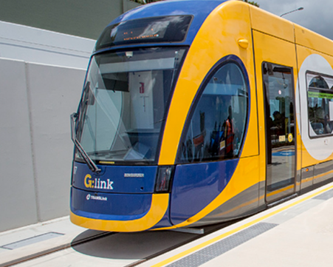
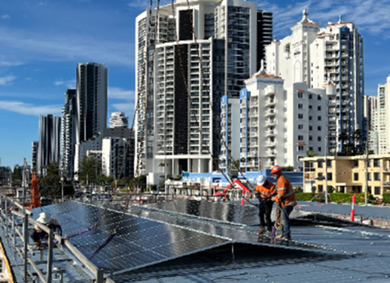
Sustainability initiatives on Stage 3
Construction projects face numerous environmental and sustainability challenges, but we have implemented a range of initiatives across community engagement, innovative practices, renewable energy, and sustainable design to address these issues and create a positive impact on both the environment and the local community.
Active travel improvements: Upgraded bike parking area at a local school, promoting active travel to and from school.
Regenerative electricity: Regenerative braking designed within the new Light Rail Vehicle fleet.
Solar array: A Solar panels on the new depot administrative building designed to generate 52,895 kWh per annum. This amount of energy can power about 5 average Australian homes for a year!
SolPod solar solution (Queensland first): re-deployable solar panels have been installed on the roofs at Broadbeach and Miami construction sites. These panels help reduce electricity use by 30% and 55%. Solar panels were also added to the new depot buildings.

Slide 14
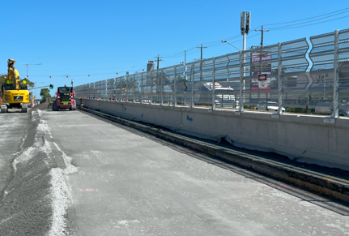
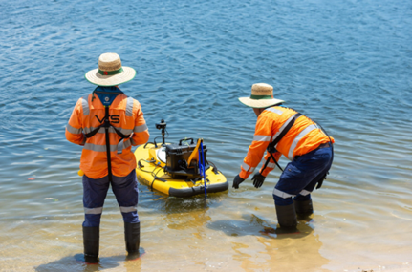
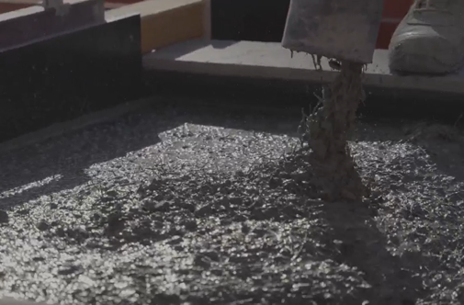
Sustainability initiatives on Stage 3
Solar hybrid light towers: Solar and solar-diesel hybrid light towers are used to illuminate the Gold Coast Highway during construction.
ZoneBloc barriers (Australia first): Lightweight, compact concrete barriers for traffic control, reduce carbon emissions and transportation fuel usage.
'The Cod Father' (Queensland first): A remote-controlled boat that helps collect water samples easily and safely, reducing environmental risks.
Supplementary Cementitious Materials (SCM): Mixing other materials with cement to replace between 41 and 68 per cent of traditional cement. This makes the construction eco-friendlier.
Fun Fact: Did you know that solar-diesel hybrid light towers can reduce carbon emissions by up to 80% compared to traditional diesel-only models?
They also operate more quietly, making them a great eco-friendly choice for construction sites

Slide 15
Infrastructure Sustainability Rating (IS)
The IS Rating is a best practice industry standard - Australia and New Zealand's only comprehensive system for evaluating infrastructure projects based on their performance in sustainability.
The Gold Coast Light Rail Stage 3 has been given a design rating of ‘leading’ by the Infrastructure Sustainability Council (ISC).

Slide 16
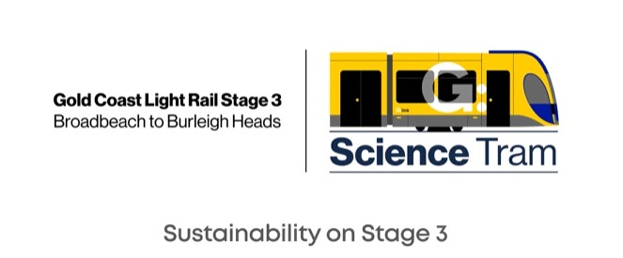
Meet the ‘Cod Father’
A unique, Queensland-first water sampling solution on Stage 3.

Slide 17
Discussion time…
Given where we live and where the project is located, what types of environmental considerations on the project do you think the Stage 3 team needs to think about?

Slide 18
Top 10 project environmental considerations
Gold Coast Light Rail Stage 3, like many large infrastructure projects, requires careful consideration of environmental factors to ensure sustainable construction practices and minimal ecological impact. Here are the top 10 environmental considerations.
Wildlife habitat preservation
Protecting local species and their habitats.
Erosion and sedimentation Implementing measures to control soil erosion and runoff.
Water quality Safeguarding local waterways from construction impacts.
Noise control Reducing construction noise to protect residents and wildlife.
Air quality management Minimising dust and emissions from the worksite.
Waste reduction Focusing on recycling and proper waste disposal.
Energy efficiency Utilising energy-saving construction methods and materials.
Cultural site conservation Preserving historical and cultural landmarks.
Vegetation management
Limiting unnecessary vegetation removal and providing offsets.
Climate adaptation Building infrastructure to withstand climate-related challenges.

Slide 19
Activity: water filtration experiment - Let’s get hands on!
Activity flyer and instructions can be downloaded from the gclr3.com.au/sciencetram website.

Slide 20
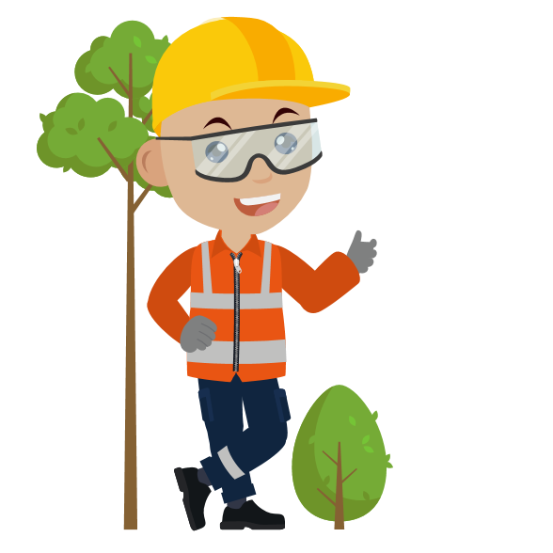
Water filtration
As part of the built environment, we have a role in protecting the natural world around us.
We must:
Preserve our environment for the future
Protect heritage
Manage environmental risks
Use resources efficiently
Prevent pollution
Respond to climate change
When construction happens, digging up soil or sand can mix with rainwater and flow into our beaches and waterways as suspended sediment.
To keep the water clean, we use several filtration methods before releasing it back into the stormwater which ends up in our waterways and beaches. Sediment heavy water blocks sunlight from reaching aquatic plants and animals, which need sunlight to support photosynthesis and the production of oxygen.
Notes:
For more resources on water quality and catchment management visit the City of Gold Coast, Healthy Waterways and Department of Environment, Tourism, Science and Innovation

Slide 21
Experiment materials
Aim
In small teams, create your own water filtration system to clean the dirty, muddy water we have provided. Who can get the clearest water?
Materials
1 cup of unfiltered, dirty water
1 empty cup
1 clear plastic bottle
Filter materials: tissues, cotton buds, sponge, cloth, fine sand, gravel, etc.
Notes:
Learning Objective – Curriculum Objectives
Create a design method.
Conduct group work and discussion.
Build techniques that civil engineers use.

Slide 22
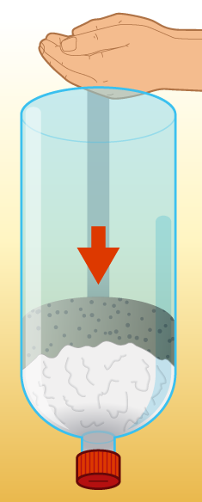
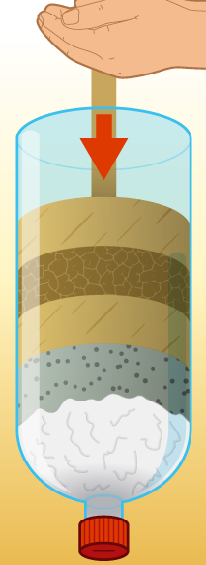
Instructions
Using the available filtration materials, create layers of filtration that will help remove impurities from the water
Be sure to keep the cap on the bottle until you are ready to filter water
Ensure cloth is the first layer
Consider how the water will flow through each of the filtration elements.
Note: this water has not been sanitised so is not safe for drinking!

Slide 23
How does sustainability relate to you?
How do environmental considerations play a role in your school's day-to-day operations, and what steps can you take to mitigate our environmental impact?
Discuss specific areas where your school could improve and propose actionable solutions?
Think about waste management, energy use, transportation, and green space at our school. What initiatives could they introduce or enhance to make your school more environmentally friendly?

Slide 24
Thank you for getting involved!
To learn more and stay up to date on Stage 3 visit gclr3.com.au

