Slide 1

Engineering on Stage 3
Classroom presentation

Slide 2
Learning outcomes
Description
The students will learn about Stage 3 engineering challenges and considerations, and how the project team mitigate these. The presentation will feature vision from the current Stage 3 construction site showcasing various aspects of design.
Students will have the opportunity to undertake their own experiment in small groups with the option to build a bridge or a catapult.
Age group
Years 7 and 8
Lesson timing
Approximately 90 minutes
Resources
Printed Careers in Construction flyer
Audio-visual equipment
Experiment materials
Aims
Provide a real-world example of how engineering principles are implemented in a project such as Stage 3
Create interest in engineering careers and explore pathways
Foster collaboration skills by working in groups to develop the best possible solution for a problem statement.
Lesson extension ideas
Create a competition to see which bridge can support the most weight
Go through the different bridge designs and discuss pros and cons of each design
Discuss the different materials used for bridges and the pros and cons for each material.
Broad Australian Curriculum alignment
General Capabilities
  Critical and Creative Thinking
Design and Technologies
Print copies of the ‘Careers in Construction’ flyer and hand out to students while discussing the different roles in a project.

Slide 3
Outline
Transport planning
Gold Coast Light Rail Stage 3
Careers in construction
Engineering challenges on Stage 3
Engineering video
Activities
Questions for discussion
Print copies of the ‘Careers in Construction’ flyer and hand out to students while discussing the different roles in a project.

Slide 4
How can effective transport planning help connect people from different neighbourhoods to essential services like schools, hospitals, and shopping centres?
Notes:
Learning extension tips – Discuss the importance of transport planning with students after watching the video

Slide 5
Benefits of transport planning and Stage 3
Integrated network: It makes sure different types of transport, like buses, trains, and bikes, work well together. This helps people switch between them easily and get where they need to go faster.
Connecting people and places: Good transport planning connects neighbourhoods, making it easier for people to reach jobs, schools, and other important places. This helps communities stay connected and active.
Accessibility: It considers everyone’s needs, including people with disabilities and the elderly. It makes sure transport options are available, affordable and easy to use for everyone.
Reducing congestion: By planning better routes and encouraging public transport, it helps reduce traffic jams, making travel smoother and quicker.
Safe travel: Safety is a big focus, with measures to protect everyone, including pedestrians and cyclists.
Reducing travel time: Efficient transport planning cuts down on travel time, so people can spend more time doing what they enjoy and less time commuting.
Improving network efficiency: It makes the whole transport system work better, ensuring resources are used wisely and services run smoothly.
Economic contribution: A well-planned transport system boosts the economy by improving access to markets, lowering transportation costs, and attracting businesses.

Slide 6
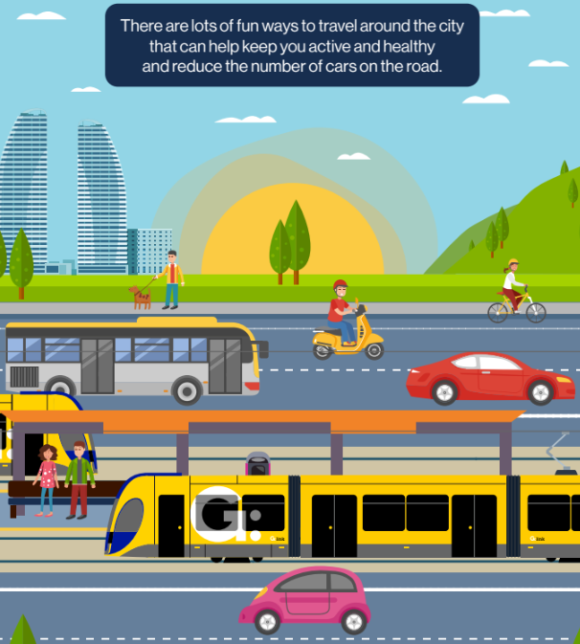
Class questions
Who has travelled on the light rail already?
How do you travel to and from school?
What modes of transport have you used to get to a beach or friends house?
Notes:
Learning extension tips – Explain what a ‘mode’ of transport is - A mode of transport is a way of moving people or goods from one place to another. Common modes of transport include cars, buses, trains, airplanes, ships, bicycles, walking and of course light rail!

Slide 7
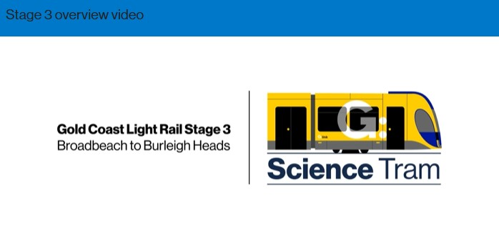
Gold Coast Light Rail Stage 3 is under construction!
Did you know?
More than 6,400 students live within 2km of Stage 3.
Let’s take a look at the project…
Notes:
Discussion – you might live within 2km of the new stage of light rail.
Let’s take a look at where Stage 3 is going [play video].
Lesson extension idea - Let’s get out a map and see where you live,. Is it close to any forms of public transport and soon to be Stage 3?

Slide 8
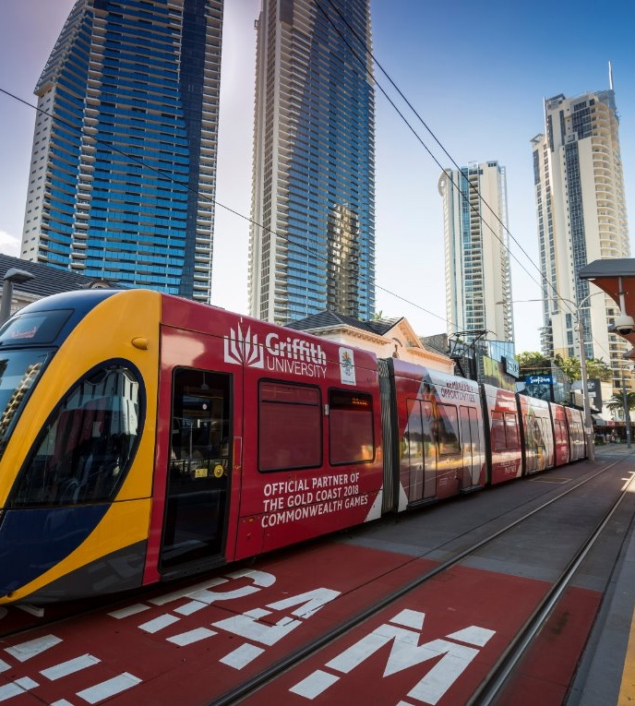
About our Gold Coast trams
Since 2014 G:link has carried more than 94 million passengers
Trams can travel up to 70km/h
Standing 3.4 metres high, 2.65 metres wide and 43.5 metres long
The trams are bi-directional which means they can travel in both directions, with a cab at each end
Designed for a capacity of up to 309 people, the trams feature air conditioning, wheelchair and multipurpose areas and even surfboard racks.

Slide 9
What jobs do we have on Stage 3?
– local people building a local project
Notes:
Discussion - There are lots of people that work to design and build Gold Coast Light Rail Stage 3. In March 2025 there were more than 800 people upgrading utilities and building light rail tracks. Maybe some of your family and friends work on the project?

Slide 10
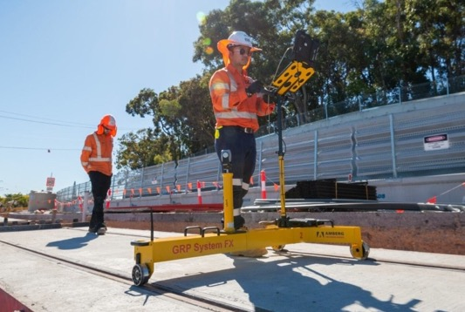
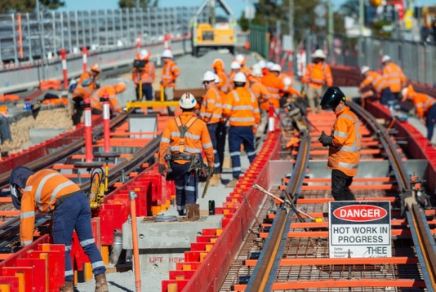
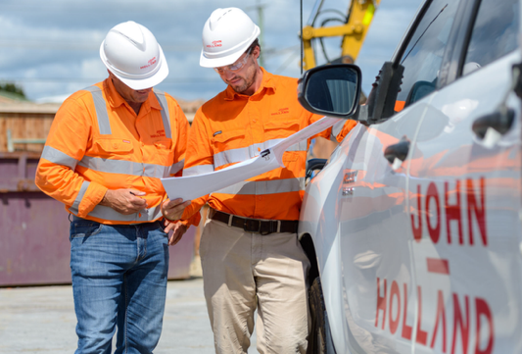
Who builds this project?
Technical roles
Workforce roles
Management and administrative roles
These include positions that focus on the technical aspects of the project, such as engineers, architects, surveyors, and site supervisors. They ensure that the project is designed and built according to specifications and safety standards.
This category encompasses the entrée level, apprentice and trainee labour force, including carpenters, electricians, plumbers, and general construction workers. These individuals are directly involved in the physical construction of the project.
These roles involve planning, coordinating, and overseeing the project. They include project managers, contract managers, procurement officers, training and administrative staff, media and community engagement officers.

Slide 11
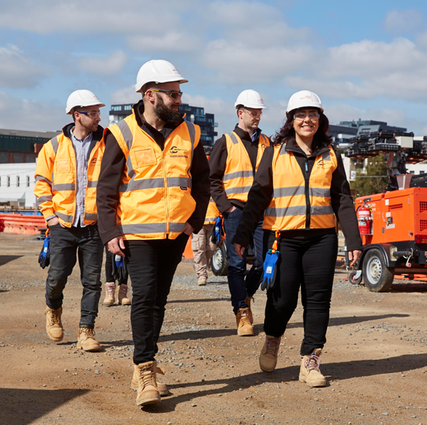
What types of engineering jobs do you find on Stage 3?
Rail Systems
Overhead
Traffic Engineering
Geotechnical
Civil
Environmental

Slide 12
Engineering challenges on Stage 3
Notes:
Discussion - There are lots of people that work to design and build Gold Coast Light Rail Stage 3. In March 2025 there were more than 800 people upgrading utilities and building light rail tracks. Maybe some of your family and friends work on the project?

Slide 13
Engineering challenges on Stage 3
Engineering challenges on a construction project such as the Gold Coast Light Rail Stage 3 can be complex and multifaceted, involving technical, logistical, and environmental aspects. Some of these challenges may include:
Integration with existing infrastructure: Integrating new utilities infrastructure and tram tracks with existing utility networks and transport systems, all while minimising disruptions to current services and traffic flow.
Environmental sustainability: Ensuring the project complies with environmental regulations, preserving local ecosystems, managing waste, and reducing the carbon footprint.
Geotechnical issues: Dealing with varying soil conditions, underground utilities, and groundwater levels that could affect the stability and safety of the construction.
Urban congestion: Constructing in built up areas close to live traffic requires careful planning to reduce the impact on local communities, businesses, and tourism.
Design and aesthetics: Balancing functionality with design that fits the local urban landscape and meets the expectations of stakeholders and the community.
Each of these challenges requires careful consideration and expert problem-solving from the engineering teams involved in the Gold Coast Light Rail Stage 3 project to ensure its successful completion

Slide 14
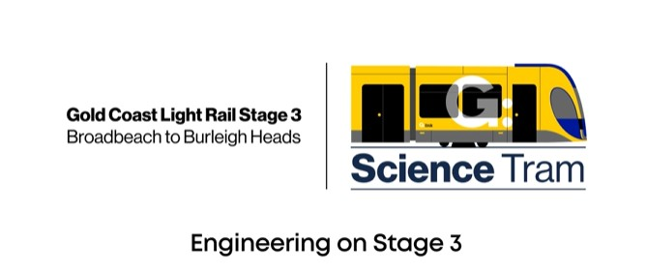
Engineering on Stage 3
Check out the effects the Gold Coast heat can have on our rail and what we do to help mitigate those issues!

Slide 15
Activity one: Spaghetti bridges
- Let’s get hands on!
Activity flyer and instructions can be downloaded from the gclr3.com.au/sciencetram website.

Slide 16
Bridge building
Aim
In small teams, build a suspended bridge which is capable of supporting the most weight. The bridge must also be self supporting from either end and span at least 20cm.
Materials
1 packet of spaghetti
1 tube of super glue
ruler
weights (books work well)
World Record - A 995kg Spaghetti Bridge held over 350kg!

Slide 17
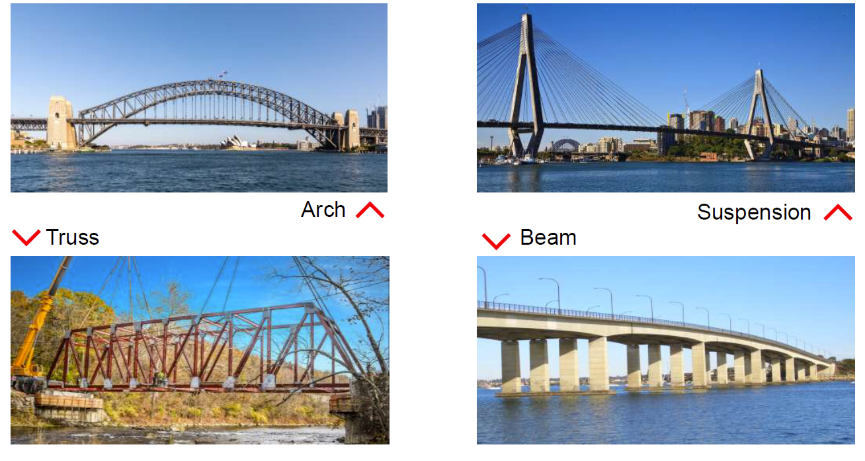
Bridge types
Notes:
Talking Points:
Types of Bridges and their supports
Why different bridge designs might be used
Talk about the importance of connections
Talk about bridges and their weaknesses
Mention the types of bridges on the right (suspension and beam) wont be suited to this exercise as they require support underneath or via cables.

Slide 18
Activity two: Pyramid catapult
- Let’s get hands on!

Slide 19
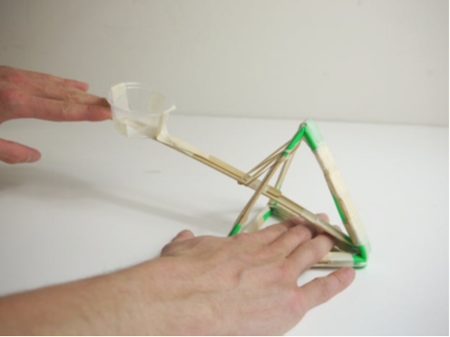
Pyramid Catapult
Aim
In small teams, work to build a catapult with a pyramid frame.
Materials
10 paddle pop sticks
5 skewers
3 straws (cut 2.5 straws into quarters)
1 small cup/container
1 rubber band
masking tape
pom poms

Slide 20
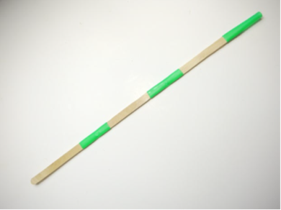
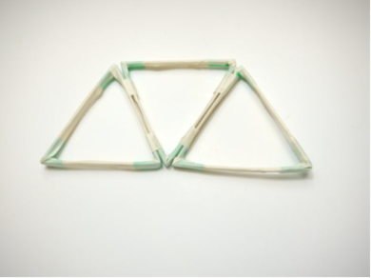
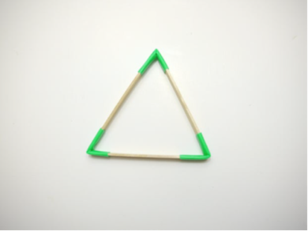
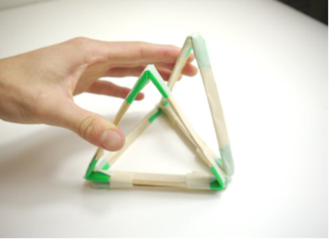
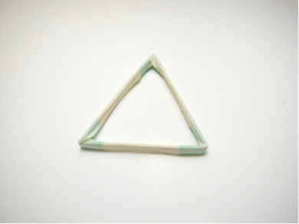
Pyramid Frame
1.
4.
​Cut 2.5 straws into quarters. Pinch the straw piece and insert a paddle pop stick. Repeat until there are 3 straw pieces, and 3 sticks connected end-to-end
Fold the shape into a triangle and connect the ends together
​Wrap the entire perimeter of the triangle in tape as you peel it off the roll
​Repeat twice to create a total of three triangles. Arrange them in a trapezoid pattern and tape the edges together
​Fold the outer two triangles upwards to form the pyramid. Tape the edge together to keep the pyramid shape intact.
2.
5.
3.

Slide 21
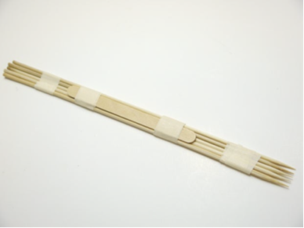
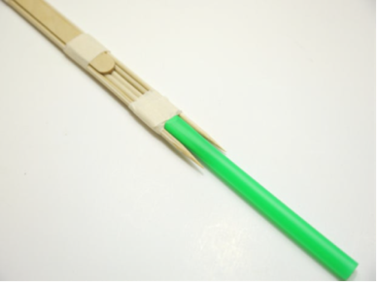
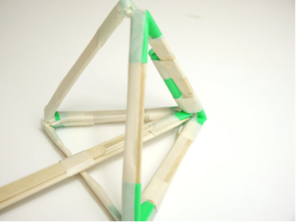
Catapult Arm
1.
​​Lay 5 skewers flat and neatly lined up. Keeping the skewers flat, wrap tape around the skewers in at least two places. Tape a paddle pop stick to the centre of the skewers to reinforce it
​Insert the pointed end of the three middle skewers into the remaining 1/2 straw piece. Tape the straw on
​Lay the skewer bundle inside the catapult and align the straw with the front of the pyramid. Tape the straw to the front edge of the pyramid. This will create a flexible joint which will allow the catapult arm to move up and down.
2.
3.

Slide 22
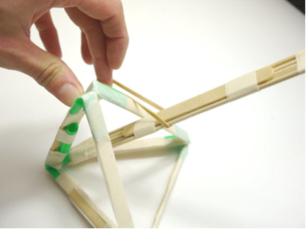
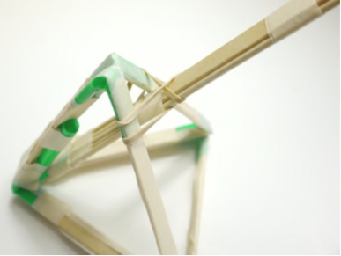
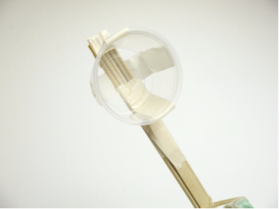
Finishing touches
1.
​​Loop a rubber band around the catapult arm, then pull it through the middle of pyramid frame (under the top point)
Stretch the rubber band and pull it over the catapult arm again
​Hold a cup near the top of the catapult arm and wrap tape to the sides of the cup. Be sure to leave some of the skewers exposed at the top of the catapult arm.
2.
3.

Slide 23
Pyramid Catapult
Before you test the Catapult…
​Make an estimate on how far you believe the catapult will fire and write it on the estimate sheet provided.
Let’s fire!
​Put a Pom Pom inside the Catapult Cup
Place one hand inside the pyramid frame and use your other hand to press down on the end of the catapult arm
Pull back, then release
​Record how far each trial travelled and compare to original estimate.

Slide 24
Discussion
- Let’s get hands on!
Activity flyer and instructions can be downloaded from the gclr3.com.au/sciencetram website.

Slide 25
Questions for discussion
What are the pros and cons of each design?
What if you could use different materials? What are the pros and cons for each material?

Slide 26

Thank you for getting involved!
To learn more and stay up to date on Stage 3 visit gclr3.com.au

