Slide 1
Safety on Stage 3
Classroom presentation

Slide 2
Learning outcomes
Description
Students will consider real life examples of safety risks specific to the design and construction of Stage 3 and identify possible risk mitigation strategies. A safety video (detailed above) will be incorporated into the presentation along with a group activity to identify safety issues from an example construction site and brainstorm safety issues and mitigations around your school.
Age group
Years 7 and 8
Lesson timing
Approximately 45 minutes
Resources
Printed Careers in Construction flyer
Audio-visual equipment
Aims
Consider safety risks specific to the design and construction of Stage 3
Identify safety risk mitigation approaches
Explore a career pathway for a career in the safety industry
Critical thinking through student identification of safety issues and mitigations.
Lesson extension ideas
Philosophical class discussion
How is safety in the home and the classroom similar to safety in construction?
Is workplace safety about behaviours or about thinking?
Broad Australian Curriculum alignment
Design and Technologies
Knowledge and Understanding: Technologies and Society
Print copies of the ‘Careers in Construction’ flyer and hand out to students while discussing the different roles in a project.

Slide 3
Outline
Transport planning
Gold Coast Light Rail Stage 3
Careers in construction
Safety advisor role
Safety video
Safety tips
Activity
Hands up survey

Slide 4
How can effective transport planning help connect people from different neighbourhoods to essential services like schools, hospitals, and shopping centres?
Notes:
Learning extension tips – Discuss the importance of transport planning with students after watching the video

Slide 5
Benefits of transport planning and Stage 3
Integrated network: It makes sure different types of transport, like buses, trains, and bikes, work well together. This helps people switch between them easily and get where they need to go faster.
Connecting people and places: Good transport planning connects neighbourhoods, making it easier for people to reach jobs, schools, and other important places. This helps communities stay connected and active.
Accessibility: It considers everyone’s needs, including people with disabilities and the elderly. It makes sure transport options are available, affordable and easy to use for everyone.
Reducing congestion: By planning better routes and encouraging public transport, it helps reduce traffic jams, making travel smoother and quicker.
Safe travel: Safety is a big focus, with measures to protect everyone, including pedestrians and cyclists.
Reducing travel time: Efficient transport planning cuts down on travel time, so people can spend more time doing what they enjoy and less time commuting.
Improving network efficiency: It makes the whole transport system work better, ensuring resources are used wisely and services run smoothly.
Economic contribution: A well-planned transport system boosts the economy by improving access to markets, lowering transportation costs, and attracting businesses.

Slide 6
Class questions
Who has travelled on the light rail already?
How do you travel to and from school?
What modes of transport have you used to get to a beach or friends house?
Notes:
Learning extension tips – Explain what a ‘mode’ of transport is - A mode of transport is a way of moving people or goods from one place to another. Common modes of transport include cars, buses, trains, airplanes, ships, bicycles, walking and of course light rail!

Slide 7
Gold Coast Light Rail Stage 3 is under construction!
Did you know?
More than 6,400 students live within 2km of Stage 3.
Let’s take a look at the project…
Notes:
Discussion – you might live within 2km of the new stage of light rail.
Let’s take a look at where Stage 3 is going [play video].
Lesson extension idea - Let’s get out a map and see where you live, places you go and other community hubs. Is it close to any forms of public transport and soon to be Stage 3?

Slide 8
About our Gold Coast trams
Since 2014 G:link has carried more than 94 million passengers
Trams can travel up to 70km/h
Standing 3.4 metres high, 2.65 metres wide and 43.5 metres long
The trams are bi-directional which means they can travel in both directions, with a cab at each end
Designed for a capacity of up to 309 people, the trams feature air conditioning, wheelchair and multipurpose areas and even surfboard racks.

Slide 9
What jobs do we have on Stage 3? – local people building a local project
Notes:
Discussion - There are lots of people that work to design and build Gold Coast Light Rail Stage 3. In March 2025 there were more than 800 people upgrading utilities and building light rail tracks. Maybe some of your family and friends work on the project?

Slide 10
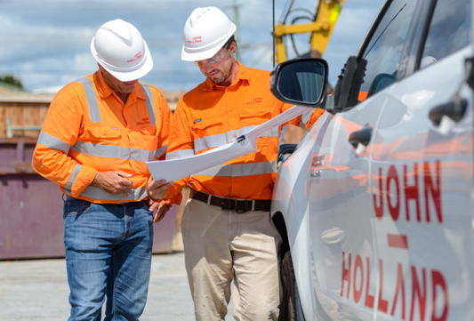
Who builds this project?
Technical roles
Workforce roles
Management and administrative roles
These include positions that focus on the technical aspects of the project, such as engineers, architects, surveyors, and site supervisors. They ensure that the project is designed and built according to specifications and safety standards.
This category encompasses the entrée level, apprentice and trainee labour force, including carpenters, electricians, plumbers, and general construction workers. These individuals are directly involved in the physical construction of the project.
These roles involve planning, coordinating, and overseeing the project. They include project managers, contract managers, procurement officers, training and administrative staff, media and community engagement officers.

Slide 11
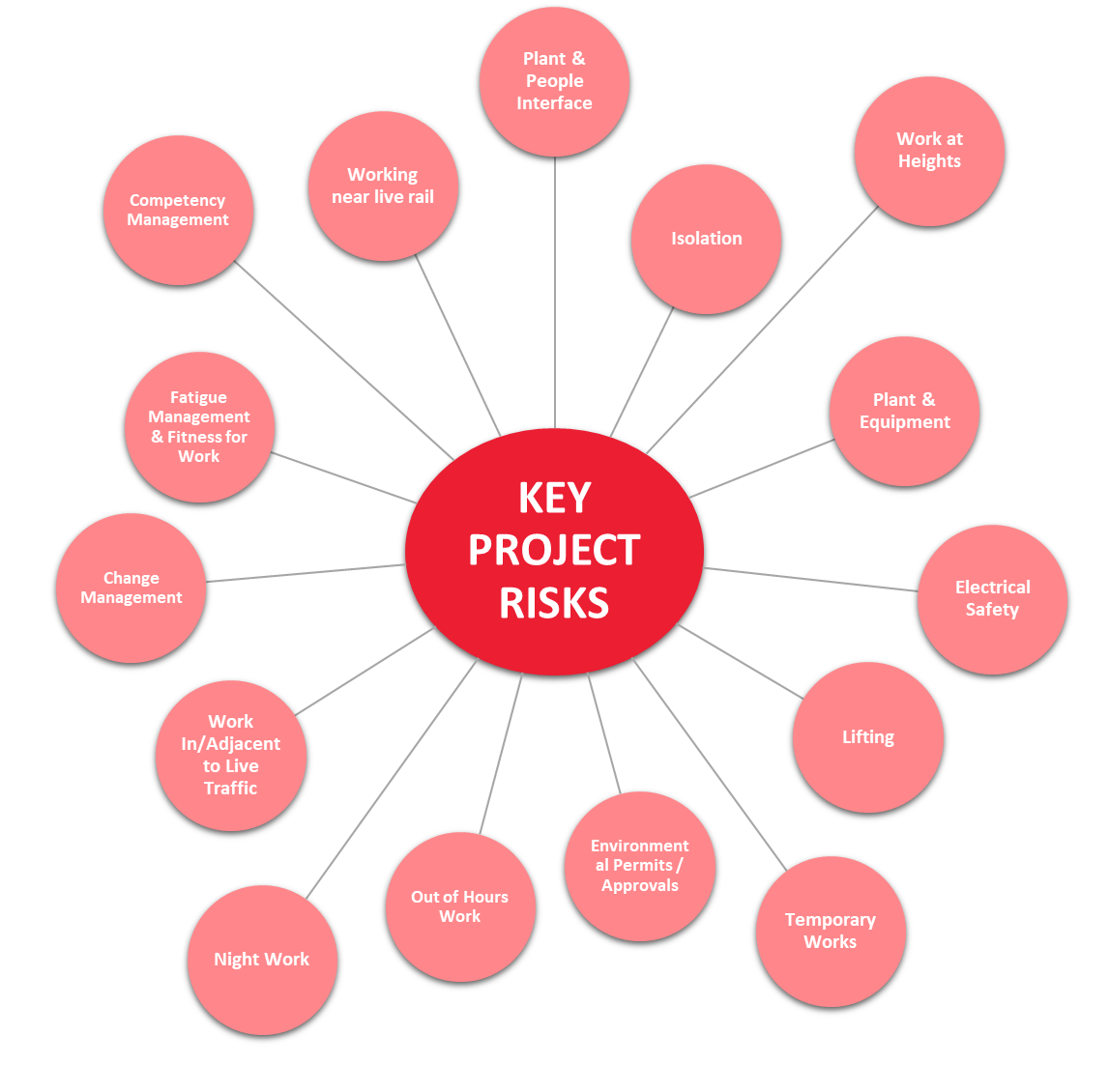
Safety on a construction project
A safety advisor ensures everyone on a construction site stays safe by identifying risks, teaching safety skills, and enforcing rules and regulations to prevent accidents, injuries, and other hazards.
Let’s take a look at some of the common project risks a safety advisor needs to consider.
Notes:
Discuss with students the types of safety considerations listed on this slide. Are there any examples students can think of that sit under each category?
Learning extension idea
– send through some questions to the Stage 3 team and we can answer them to share in your lesson
- How does safety differ between a construction site and home or your school?

Slide 12
Safety advisor on Stage 3
A day in the life of a Safety Advisor!
Notes:
Discussion – you might live within 2km of the new stage of light rail.
Let’s take a look at where Stage 3 is going [play video].
Lesson extension idea - Let’s get out a map and see where you live, places you go and other community hubs. Is it close to any forms of public transport and soon to be Stage 3?

Slide 13
Safety tips recap
Avoid uneven ground, sharp objects, or loose wires, and other trip hazards
Always use designated pedestrian crossings when crossing tram tracks and roads
Pay attention to signs, signals, and traffic controllers
Stay away from restricted or fenced-off construction areas as they can be dangerous
Pause your tunes and look up from your phone – stay alert and stay safe
And finally, speak up! Tell an adult if you think anything is unsafe. They can help fix the problem and keep everyone safe.
Notes:
Discussion – you might live within 2km of the new stage of light rail.
Let’s take a look at where Stage 3 is going [play video].
Lesson extension idea - Let’s get out a map and see where you live, places you go and other community hubs. Is it close to any forms of public transport and soon to be Stage 3?

Slide 14
Activity
Spot the potential safety issues

Slide 15
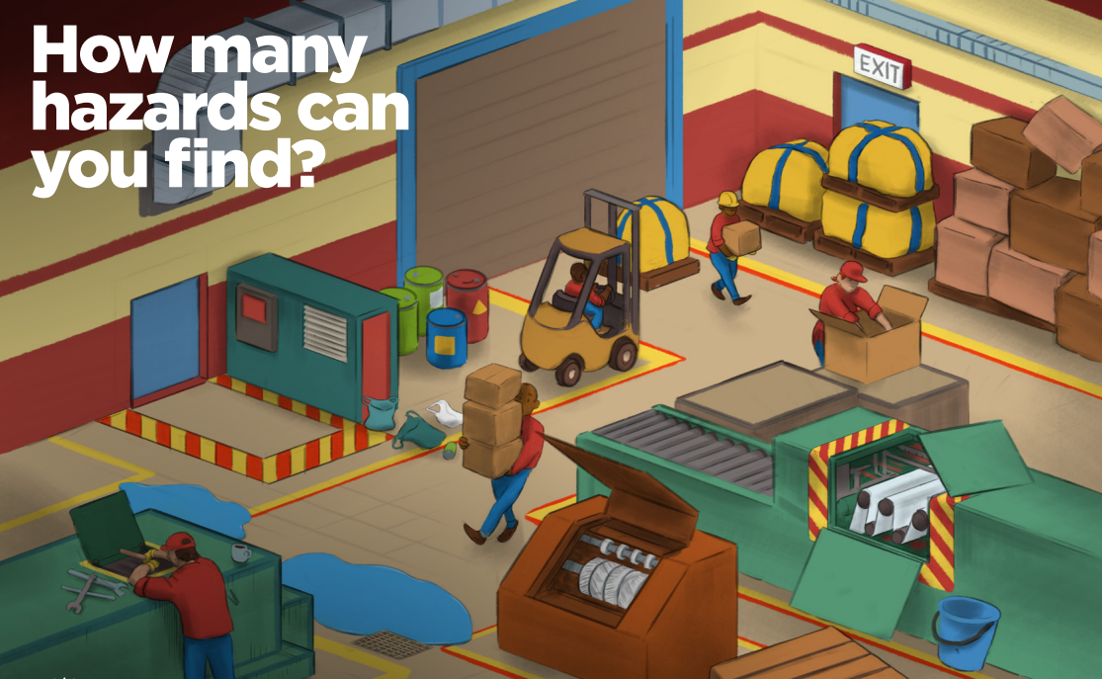
Ctrl + click on the picture for interactive experience
Notes:
Visit the interactive activity and discuss the image with students as a class or in groups to identify potential safety issues and what mitigations could be developed to reduce the risk.
Learning extension idea – students work in groups to audit the classroom or school areas and identify potential risks and issues.
This image shows these safety hazards:
rubbish on ground
unsecured chemicals
a machine with guarding that's been lifted
water on floor, which is a trip hazard
pallets of material stacked unevenly against a wall
a worker walking in front of a forklift
pallets of goods blocking a fire exit
a forklift being stacked to high and the driver being unable to see

Slide 16
Safety tips true or false?
True or False: You should avoid uneven ground, sharp objects, loose wires, and other trip hazards
True or False: Always use designated pedestrian crossings when crossing tram tracks and roads
True or False: It is important to pay attention to signs, signals, and traffic controllers
True or False: You should stay away from restricted or fenced-off construction areas as they can be dangerous
True or False: It is safe to listen to music and look at your phone while walking through a construction site
True or False: If you think something is unsafe, you should speak up and tell an adult
Notes:
Hands up survey – we encourage teachers to undertake a ‘hands-up’ true or false questionnaire to gauge the knowledge and understanding of key safety tips following the lesson materials.
Send the results to the Stage 3 project team at contact@gclr3.com.au with your school's name, class student numbers and results so we can continuously improve lesson materials.

Slide 17
Thank you for taking part!
To learn more and stay up to date on Stage 3 visit gclr3.com.au

